Slide 2
API Wars: The Rise of Custom Integrations in Dynamics 365 F&O
Nathan Clouse

Slide 3

Speaker
Nathan Clouse
Senior Director, D365 Solutions
Wineshipping
Microsoft MVP 6x
nathan.clouse@wineshipping.com

Slide 4
Agenda
Discuss inbound integration tech
How to use it
When to use it
Overview of how to configure
Talk through examples
How do I know what to use for what?

Slide 5
The Battle Lines

Slide 6
Data Inbound
OData
X++/C#
Microservices
DMF APIs
Custom Services
Recurring Integrations

Slide 7

OData
REST Endpoints from Data Entities
Most data entities are OData entities
Support CRUD Operations
Simple and fast but “expensive”
Throttled so good for low volumes
Can also work with moderate volumes
Use outside scheduling to orchestrate volume
Once throttling kicks in, best of luck.
Unmanaged endpoints
Honorable Mention: OData Actions

Slide 8

Custom Services
SOAP or JSON based endpoints
CRUD Operations plus processes
Complicated and fast
Throttled
Per interaction, not per page
Can work with moderate to high volumes
Use outside scheduling to orchestrate volume
Unmanaged Endpoint
Honorable Mention: Do whatever you build them to do

Slide 9

DMF APIs
MSFT Delivered REST endpoints just for DMF
Can create, orchestrate, update, delete DMF projects
Powerful when orchestrating known and mapped data sources
Workload happened in batch but real time

Slide 10

Recurring Integrations
Additional REST Endpoints configured on request inside DMF
Inbound: Accept messages and process in a batch job based on preset schedule
Outbound: generate messages for retrieval in a batch job based on a preset schedule
Process individual files or data packages
Great for volume but complex

Slide 11

X++/C#
Build what you need in x++ supported by C#
F&O primarily orchestrating the communication with outside systems
F&O has a queue system also
Lots of different options
Blob storage, queue, tables, (outside) SQL, file shares, etc

Slide 12
Jedi Training

Slide 13
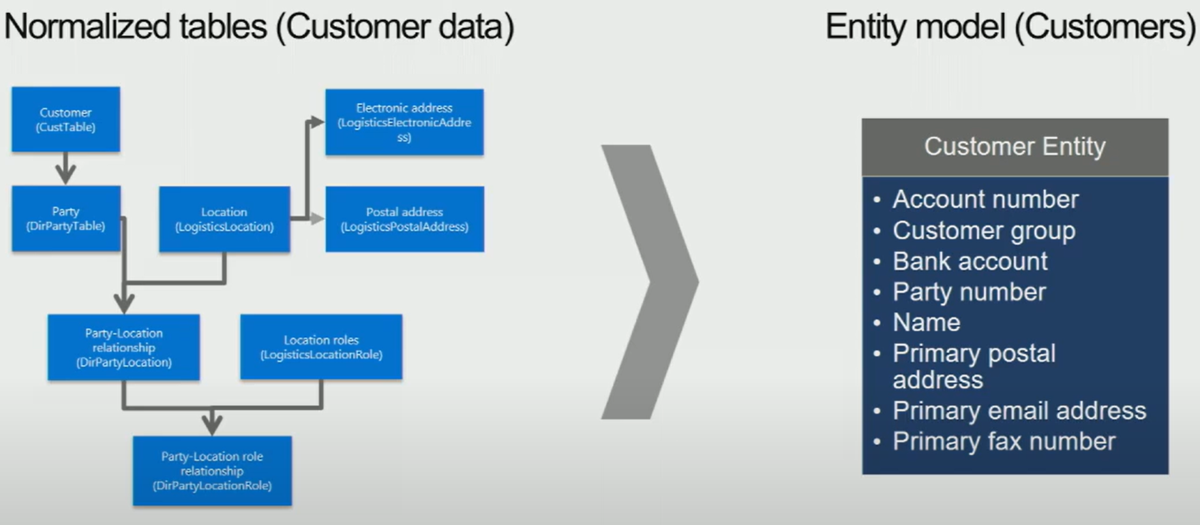
Data Entities

Slide 14

Data Entities
How to make
Add “/data” to your environment URL to see all OData entities
Add “/data/$metadata” to get the meta data file for OData endpoints

Slide 15

Custom Services
A few OOTB services from MSFT
Add “api/services” for JSON
Add “soap/services/<service>?wsdl” to get WSDL
Extension for what is there
MSFT mostly makes services for themselves

Slide 16

DMF APIs and Recurring Integrations
Build Project
Execute Projects
Send and Receive Messages
Specific endpoints to use for these
Same filtering and transform options as DMF
“Automated DMF”
Build in DMF, Automate with middleware (Logic Apps, Function Apps )

Slide 17
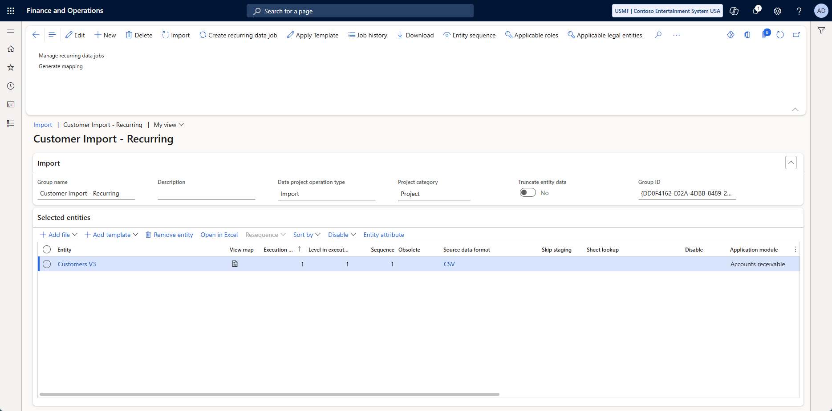
Recurring Endpoints Setup

Slide 19
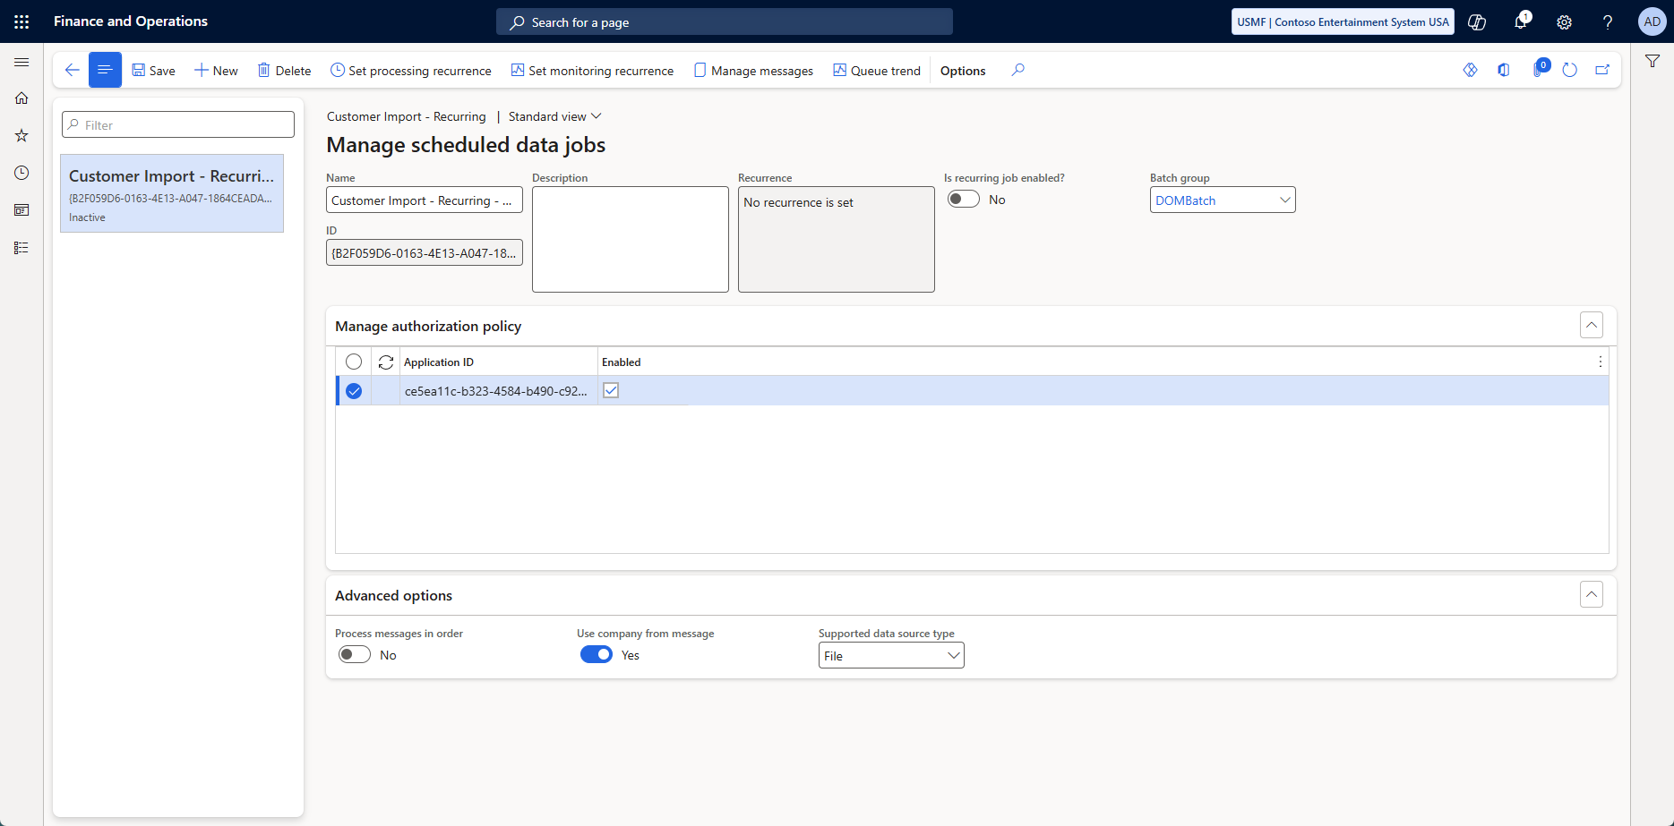

Slide 20
Recurring Endpoints Setup

Slide 21

Recurring Endpoints Setup
https://<base URL>/api/connector/enqueue/<activity ID>?entity=<entity name>
https://<base URL>/api/connector/dequeue/<activity ID>

Slide 22
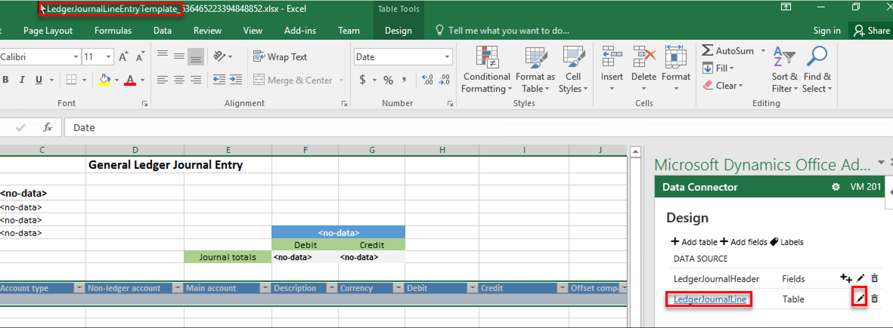
Excel Add-in

Slide 23
Securing The Galaxy

Slide 24

Security
Security
OAuth 2.0 (standard)
App Registrations and F&O
FO Users imply Legal Entity
Integrations use User Legal Entity
Must manage what gets created where
Must manage who can see what
Application ID relates to user in F&O
Users relate F&O security
Application ID allow access to endpoints
F&O security allows F&O permissions

Slide 25

Security
You build it
Users
Application Id in Azure/Entra
Associate User(s) to Application Id in F&O
You hand it out
Consumers of endpoints get an application ID and an application secret
They get a bearer token to talk to F&O
They present the token and app id to F&O to connect and talk

Slide 26

API Management
More features
Consumer security
Versioning
Policies
Expose APIM rather than APIs directly
F&O APIs are unmanaged
APIM can manage them
“IIS in the middle”

Slide 27
High Performance API Tactics

Slide 28

OData
Retry (429)
Filter
Paginate / Skip-and-Take
Limit
Select columns
Can be built with advanced measures
Order by
Count
Batch via Changesets
Company Scope

Slide 29

Custom Services
Typically, you build what you need
Make the contract
Make the code that processes the contract
Error handling and processing
Handle system processes / Postings
Post SO Packing Slip
Post Inventory/Ledger Journal
Can also do CRUD

Slide 30

DMF APIs
Build Project
Execute Projects
Send and Receive Messages
Specific endpoints to use for these
Same filtering and transform options as DMF
“Automate DMF”

Slide 31

Recurring Integrations
Send and Receive Messages
Specific endpoints to use for these
Same filtering and transform options as DMF
“Automated DMF”
Build in DMF, Automate with middleware (Logic Apps, Function Apps )
Schedule for processing built into integration setup

Slide 32

Synchronous vs Asynchronous
Interactive vs Batch
OData – Synchronous
DMF API – Synchronous / Asynchronous
Recurring – Async
Custom Services - Synchronous

Slide 33
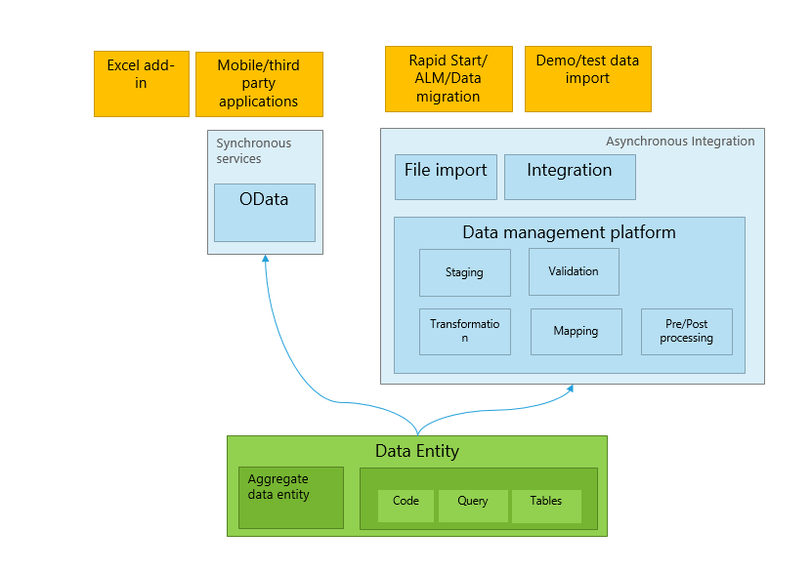
DMF

Slide 34

Monitoring and Telemetry
Use Monitoring and Telemetry Feature
Use APIM for advanced logging and telemetry
Build log tables in F&O for custom workloads
Use process automations to clean up tables
Move data to cheaper storage if you need it long term

Slide 35
The way of the Jedi

Slide 36
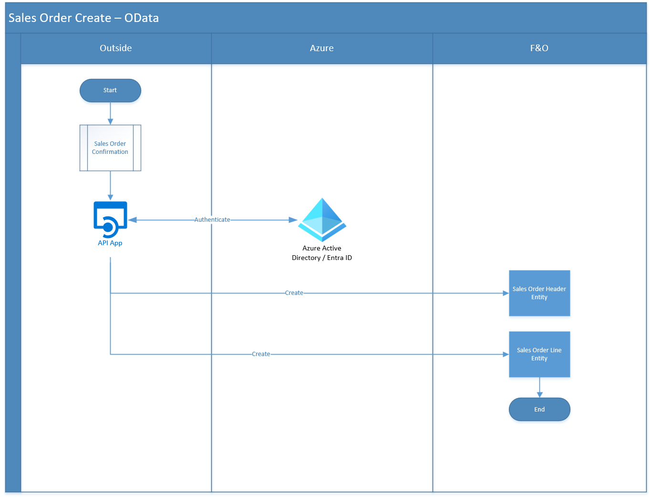

Slide 37
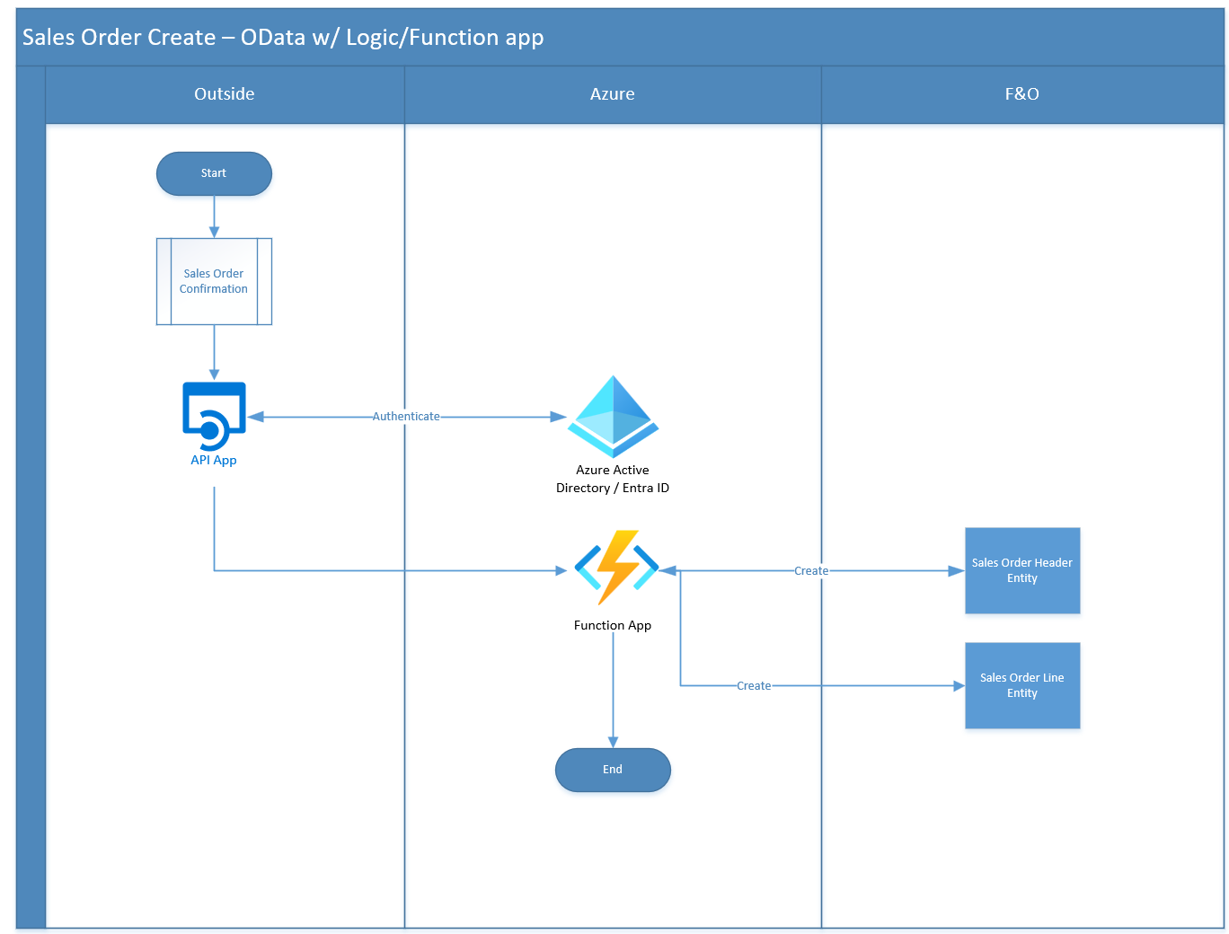

Slide 38
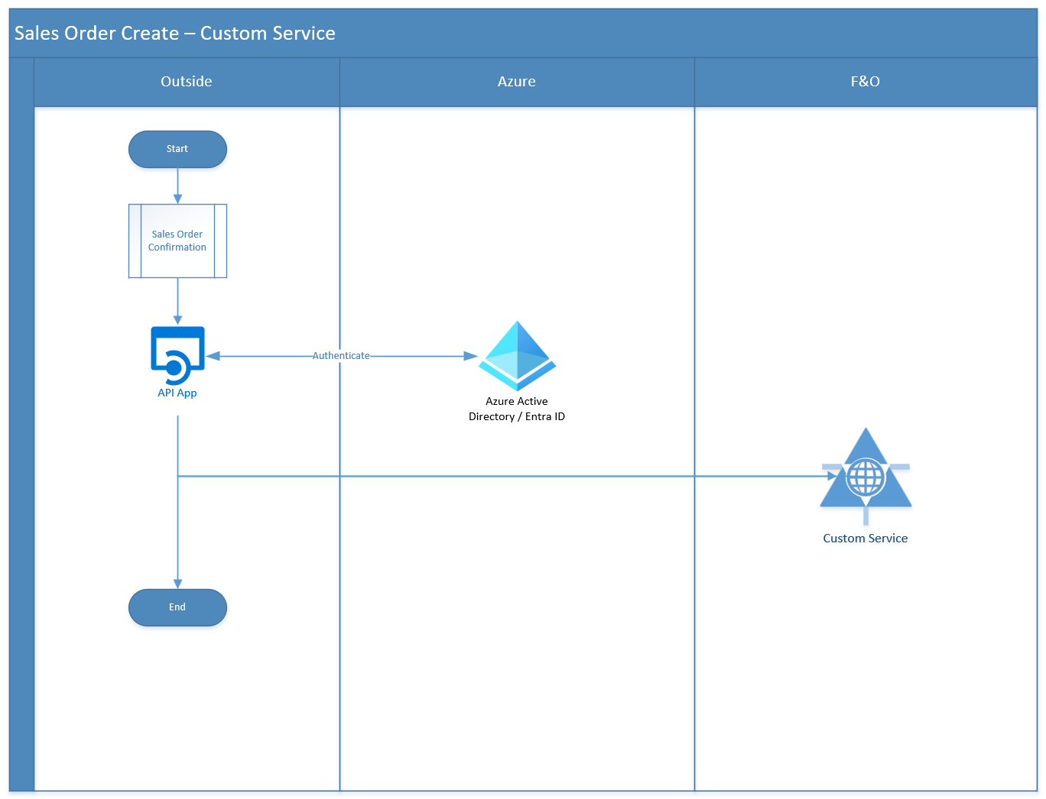

Slide 39
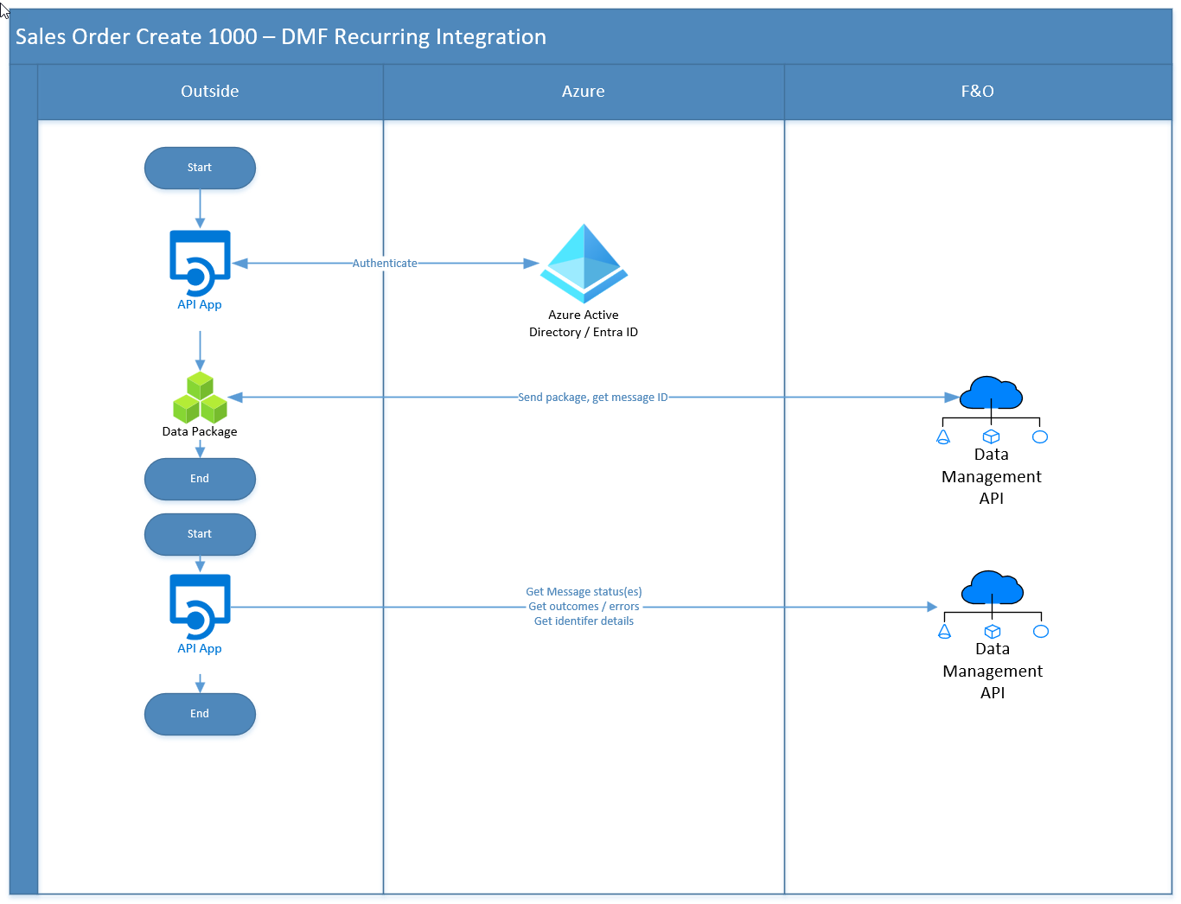

Slide 40
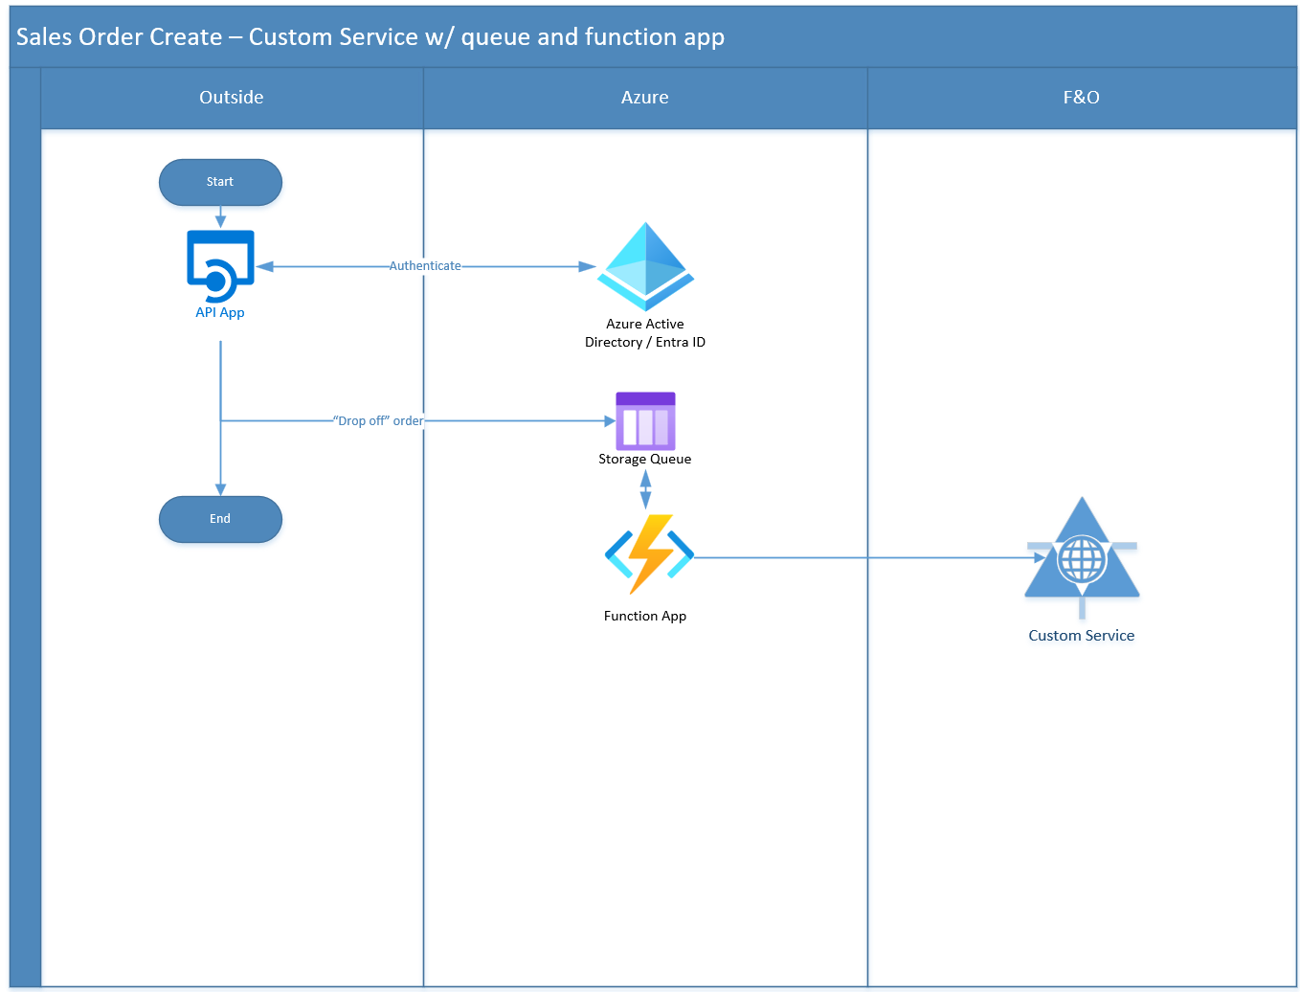

Slide 41
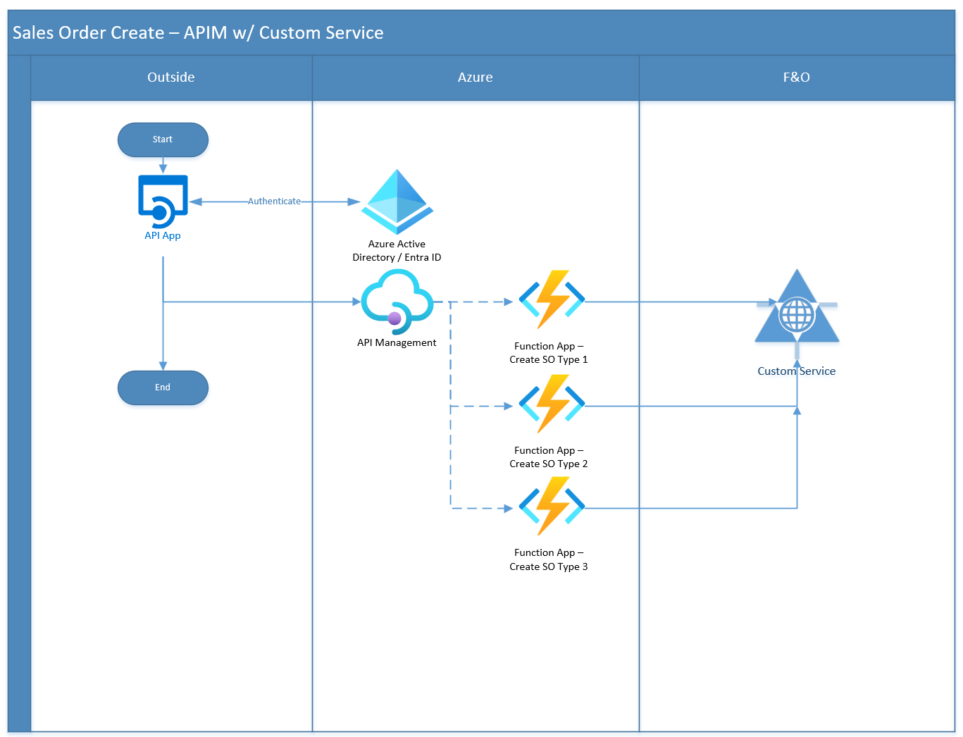

Slide 42
Lightspeed Wrap-up

Slide 43
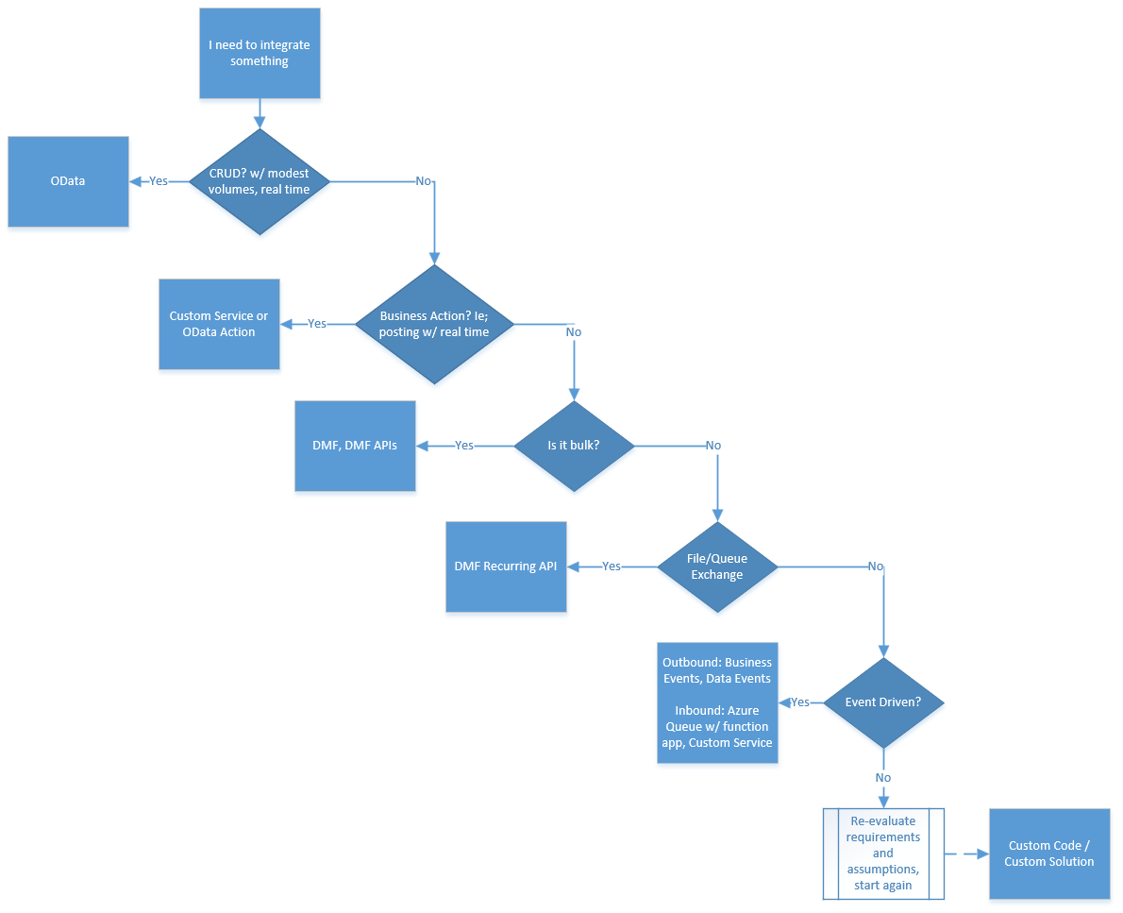

Slide 50
References
https://learn.microsoft.com/en-us/dynamics365/fin-ops-core/dev-itpro/data-entities/recurring-integrations
https://www.postman.com/anthonyblakedev/dynamics-365-finance-apis/overview
https://www.atomicax.com/content/odata-experiment-deep-dive-odata-and-how-use-it

Slide 51
THANK YOU!
Questions?

